Slide 1
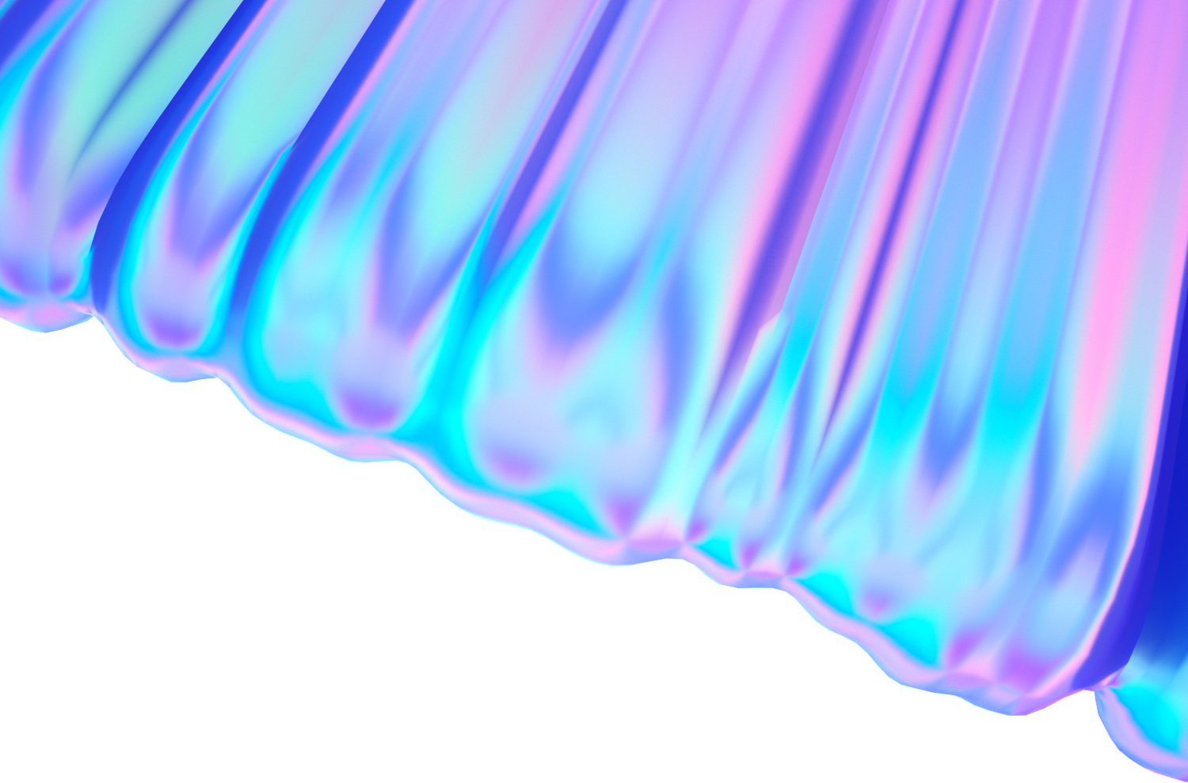
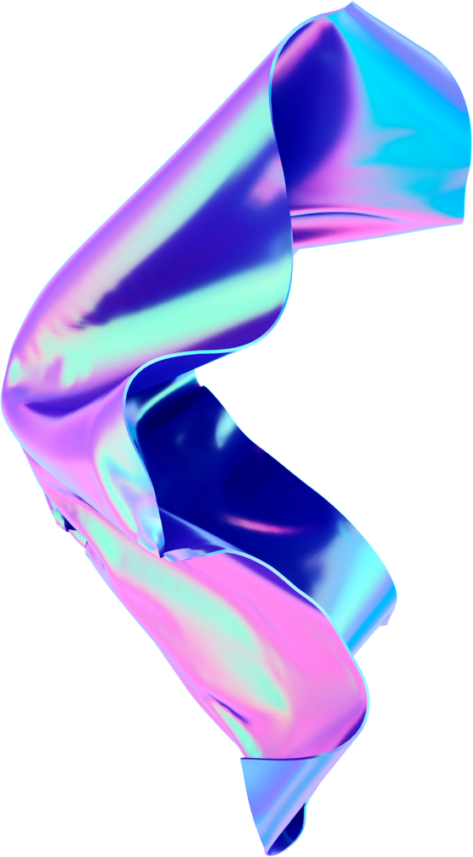




COMPUTER
VISION

Slide 2
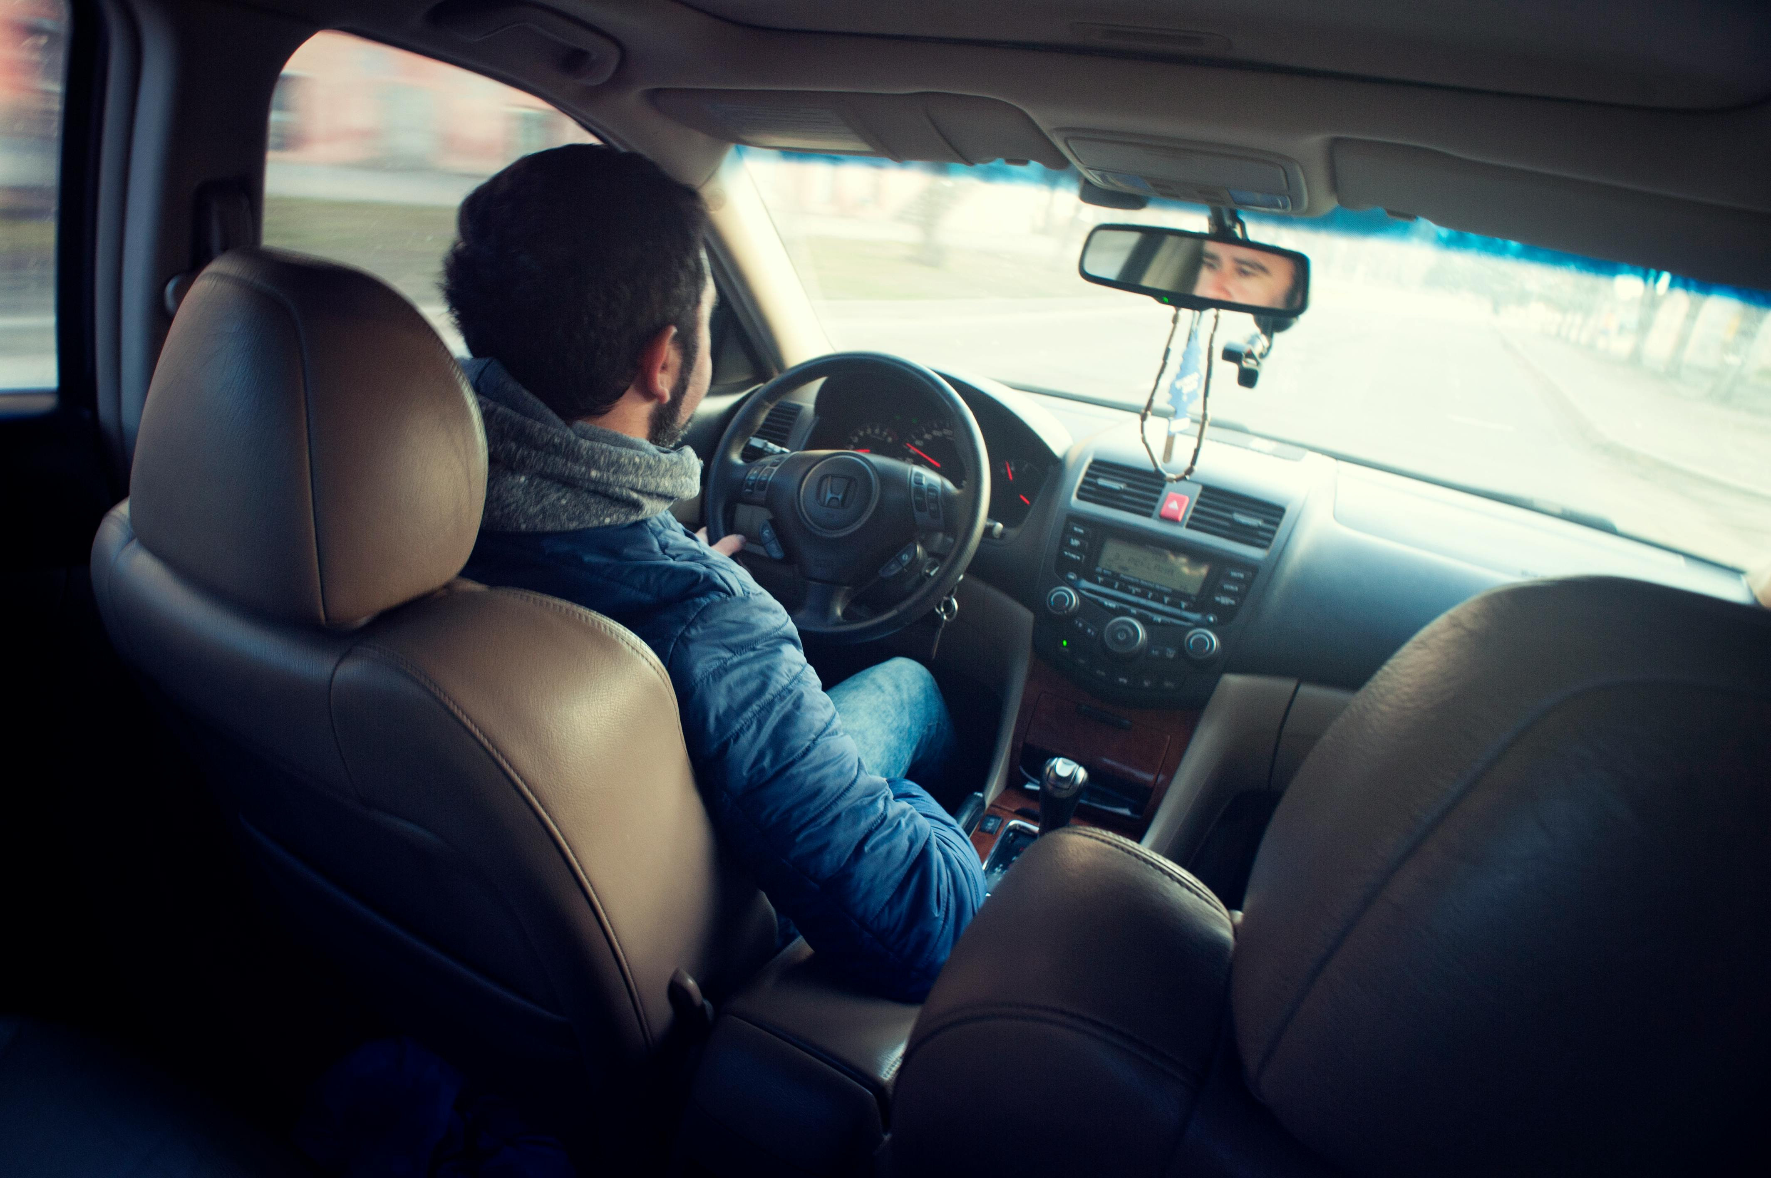
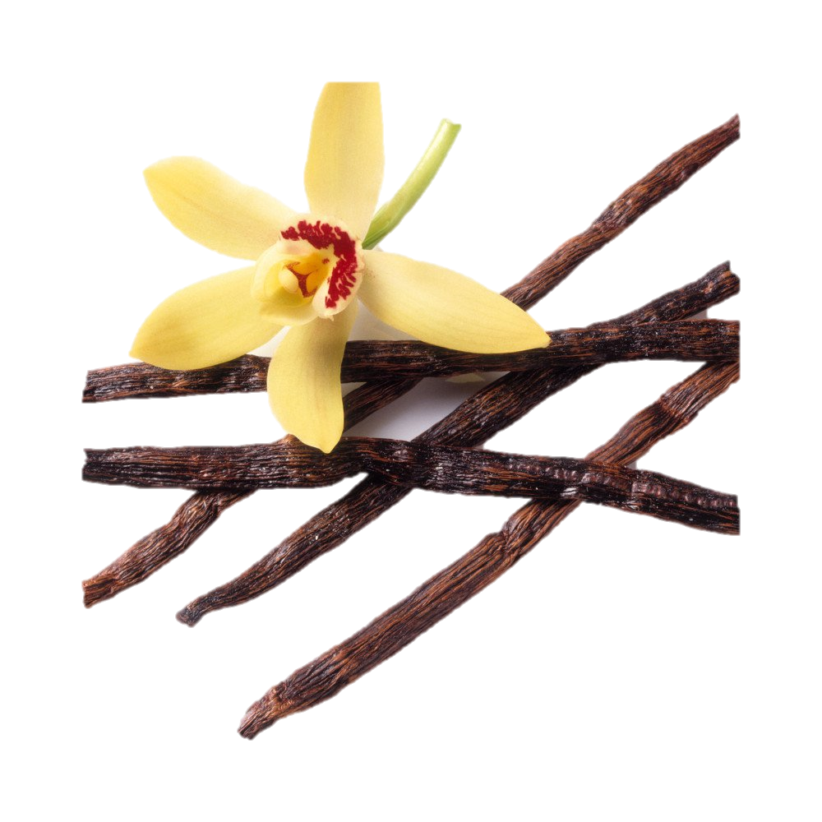

Distracted Driver Detection
Presented By:
NOOR-UL-HUDA(037)
HASAAN EJAZ(O13)
FARHAN AHMAD(052)

Slide 3
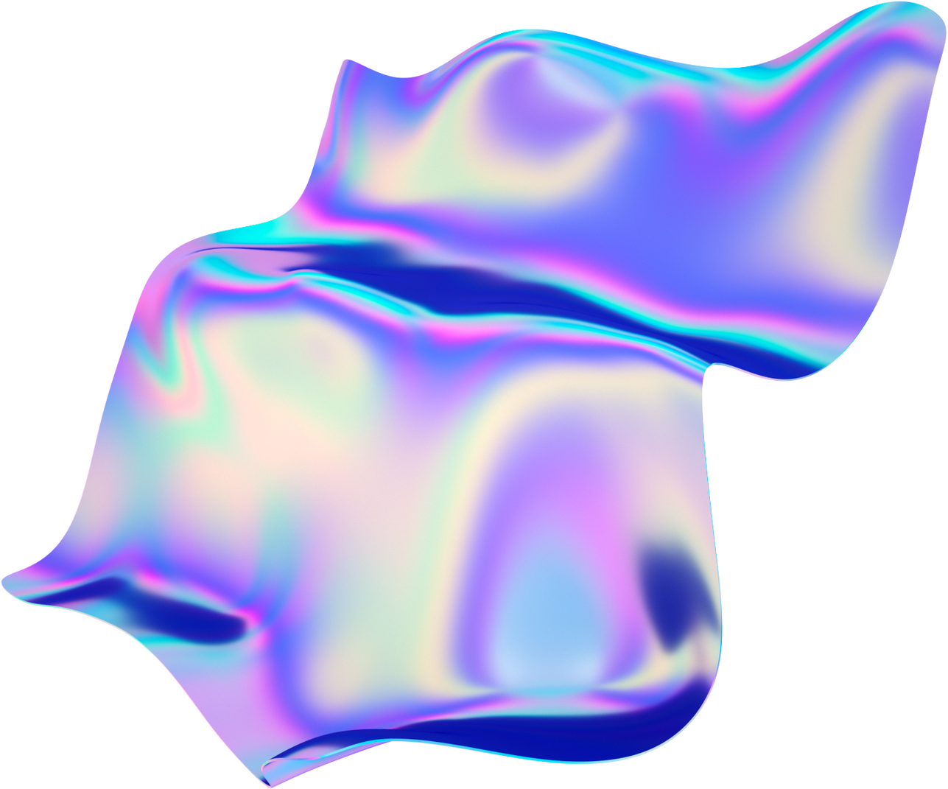

Problem
Manual Observation and Reporting
Lack of Real-Time Monitoring
Dependence on Facial Expressions
Challenges with Data Diversity

Slide 4
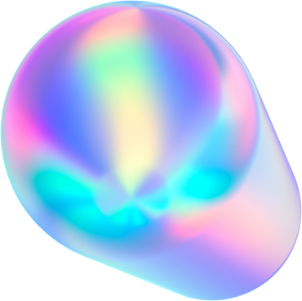

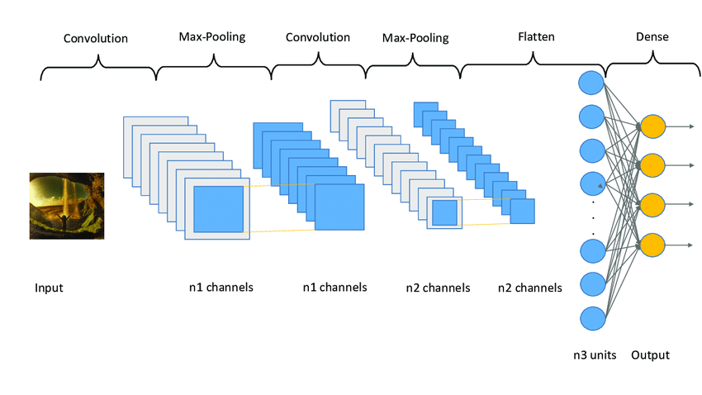
Proposed Solution
A Cnn-based model trained on diverse data

Slide 5

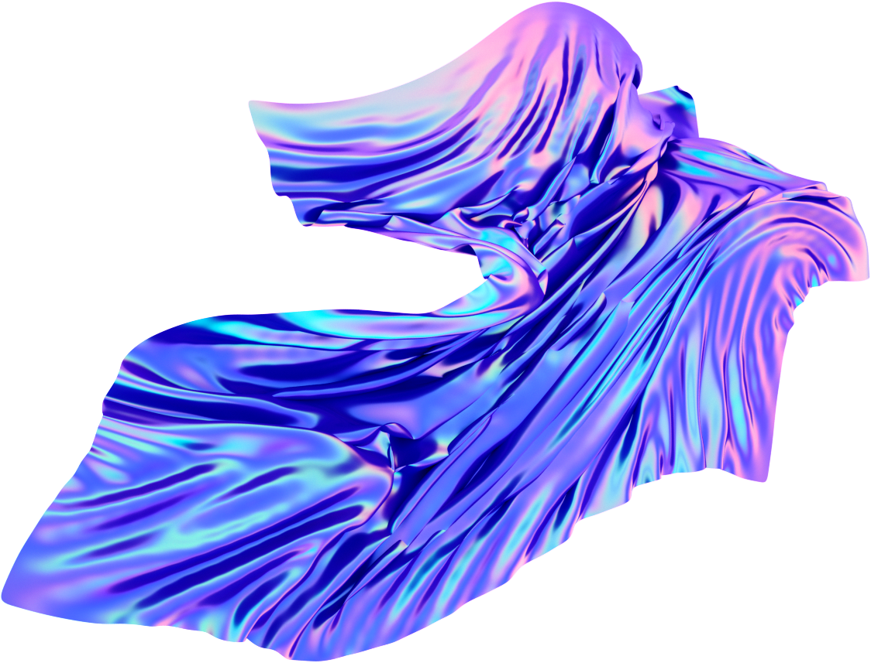

Loading Dataset
Normalizing
Implementing Model
Model Training
Testing
Prediction
Deployment

Slide 6
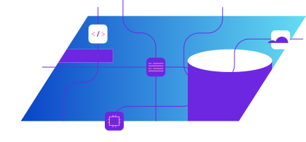
Loading Dataset
Normalizing
Class Mapping
Implementing Model
Model Training
Testing
Prediction
Deployment

Slide 7
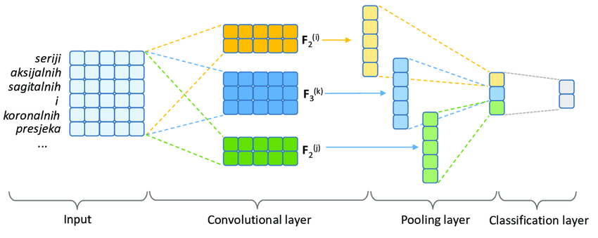
Feature Extraction:

Slide 8
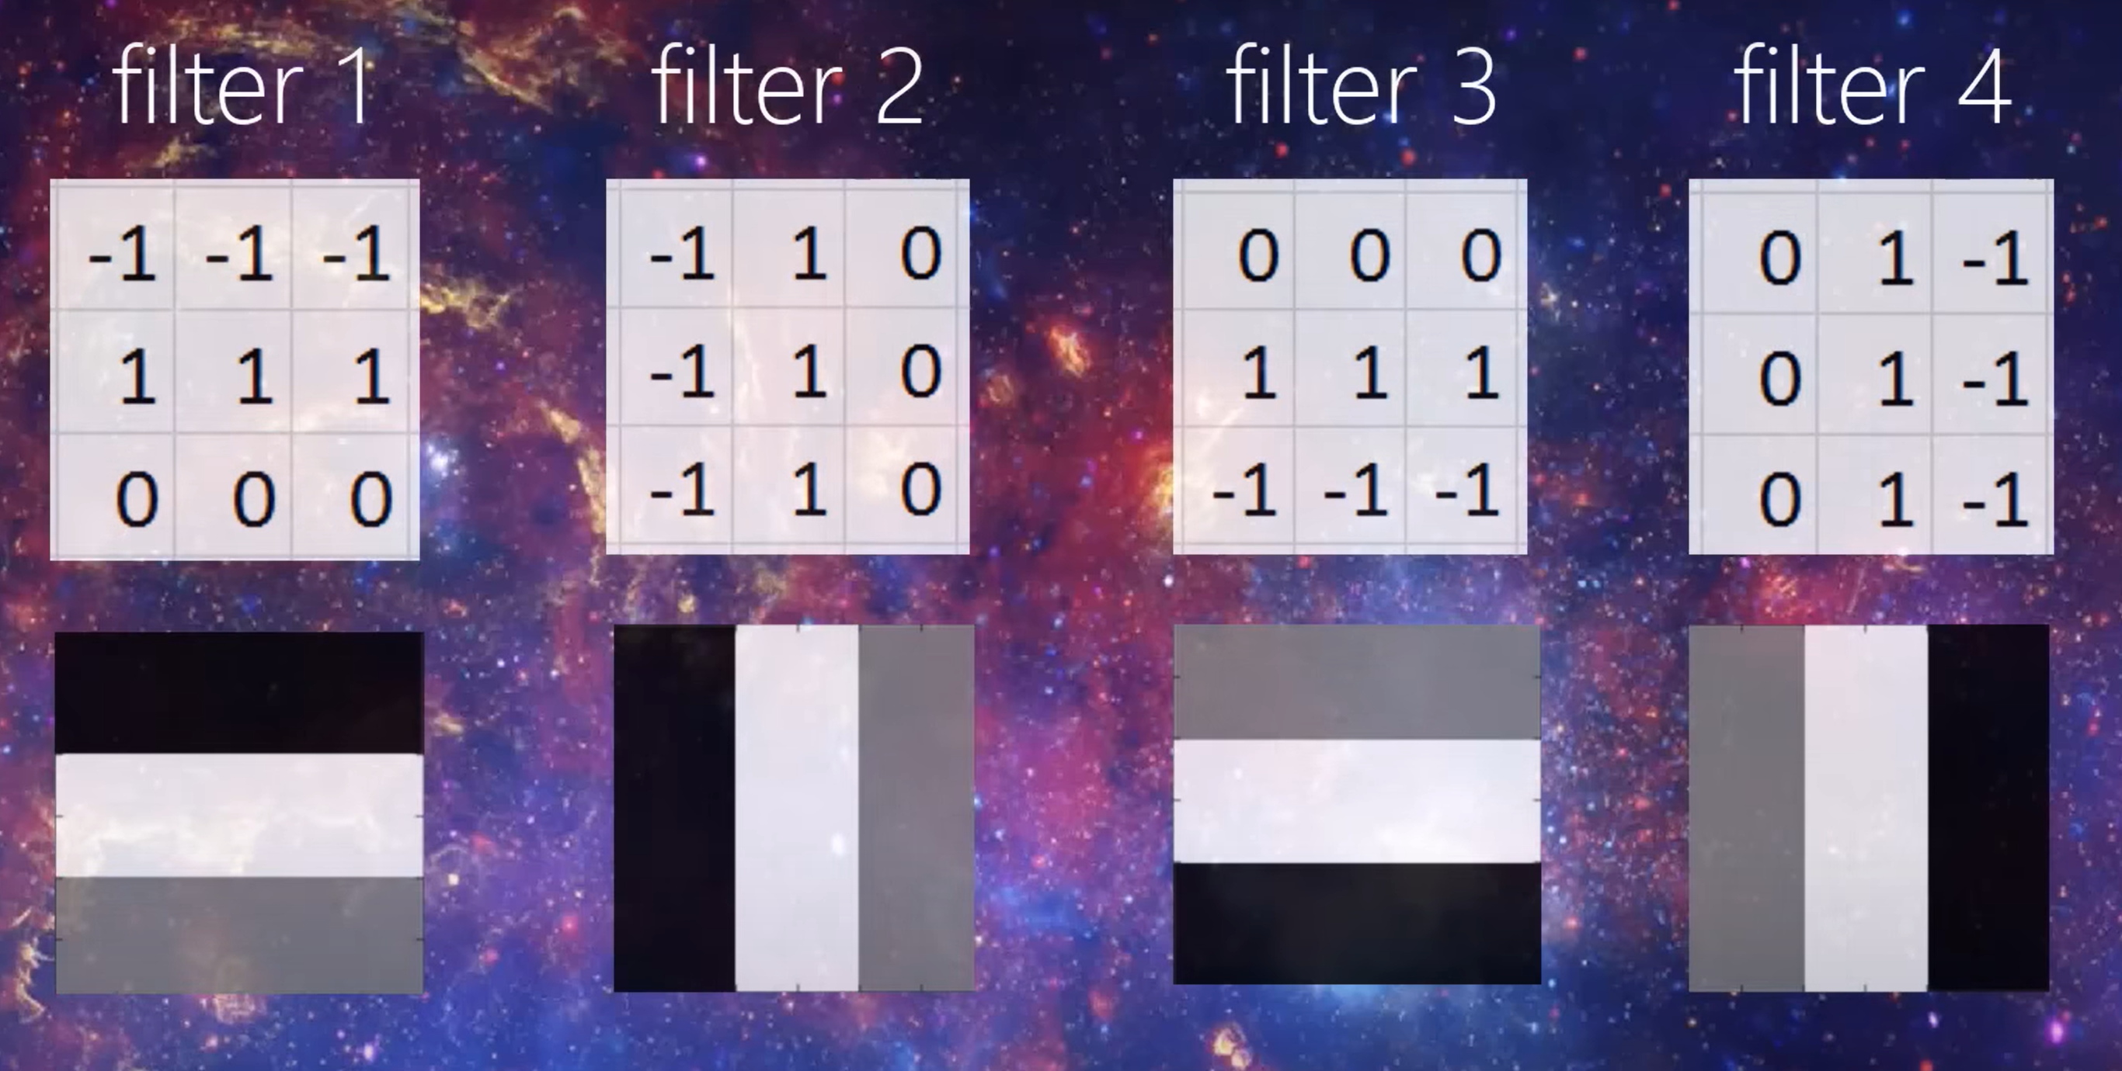
Filters

Slide 9
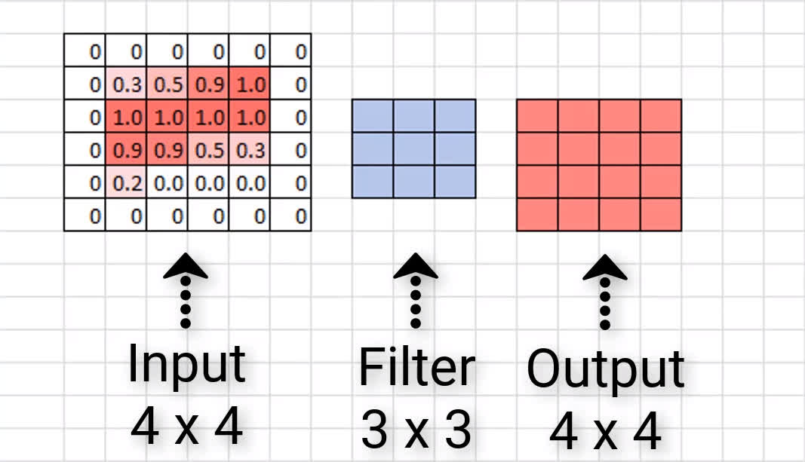
Padding:

Slide 10

Types of Layers:
Max Pooling
Reduces spatial dimensions by downsampling leading to reduced computational load, extracting dominant features.
Dense
Connects all neurons in the previous layer to each neuron in the current layer.
Convolutional 2D
Extracts local features from images.Captures patterns like edges, textures, and shapes.
Dropout
Randomly sets a fraction of input units to zero. Prevents overfitting during training.
Flatten
Converts 2D feature maps into a 1D vector.
Dense
Applies weights and biases to the feature vector with an activation function majorly used in output final class predictions.

Slide 11
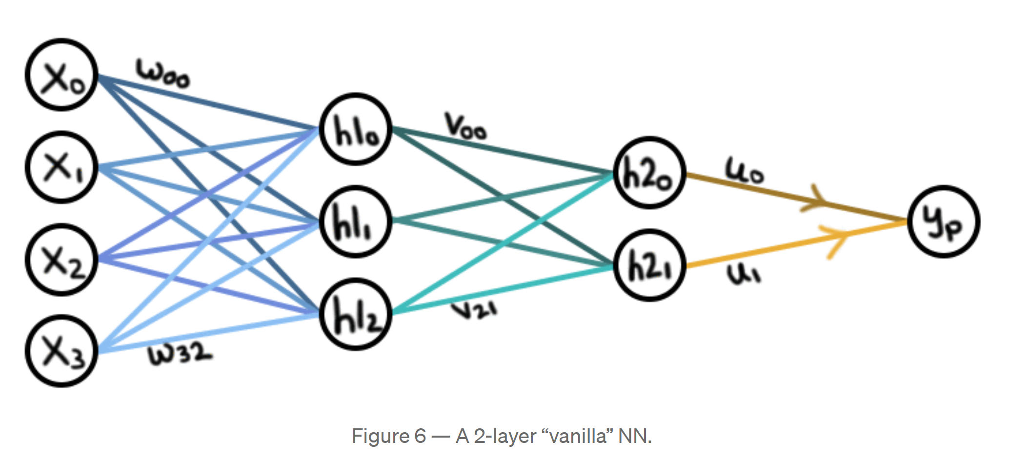
A 2 Layer Vanilla Model

Slide 12
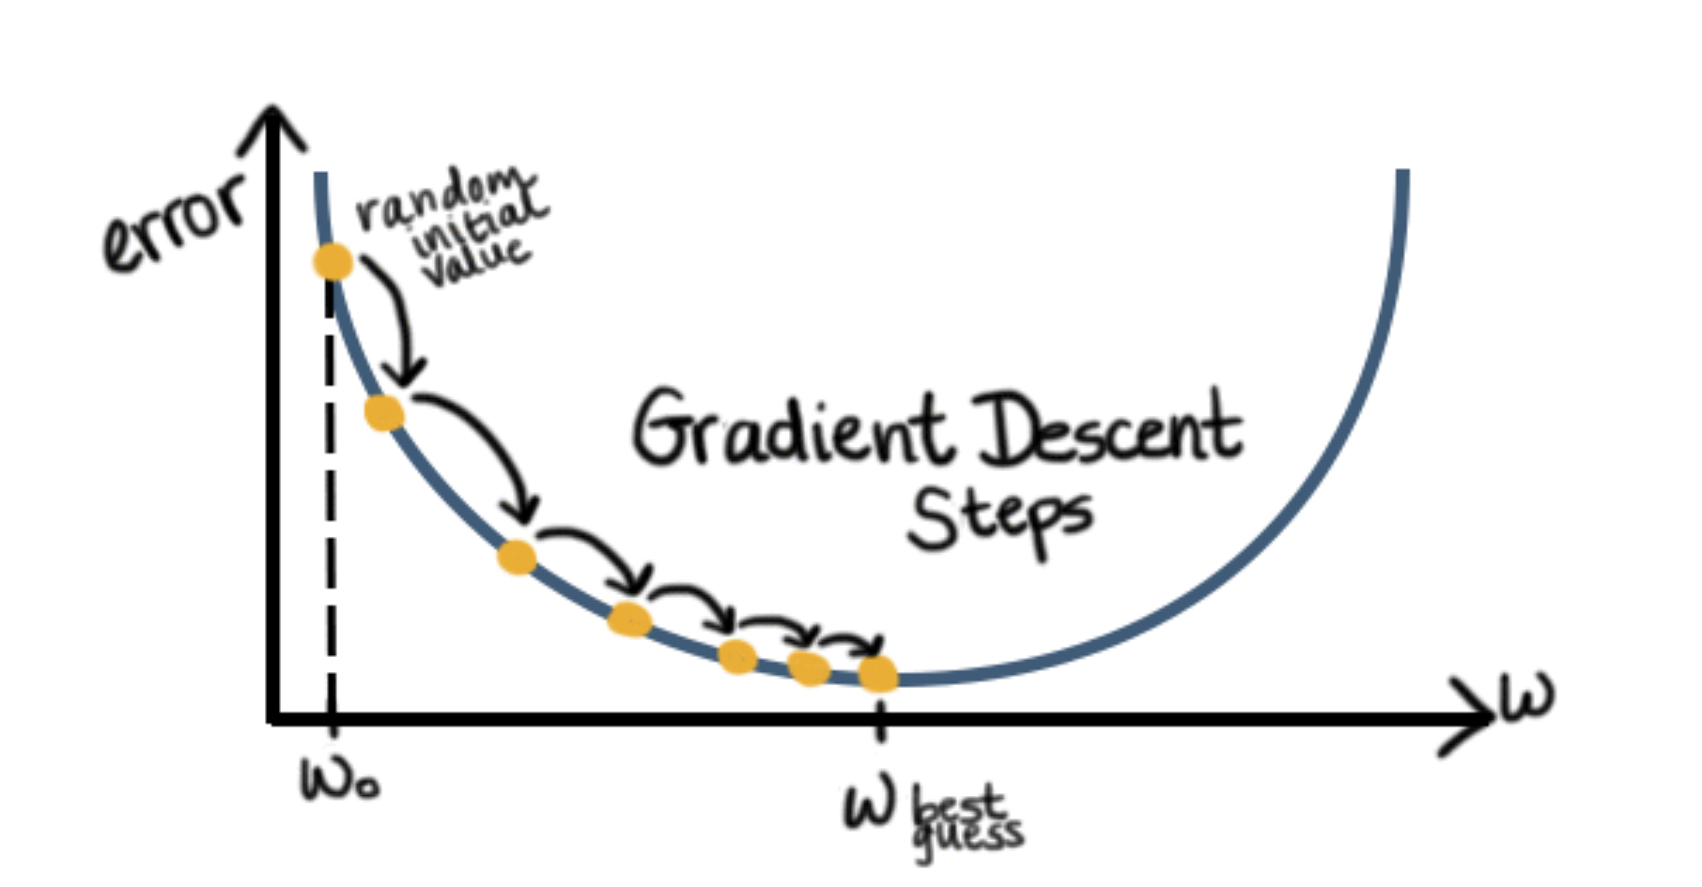

Slide 13

Gradient Descent Optimizers Finding the goal i.e. steepest slope

Slide 14
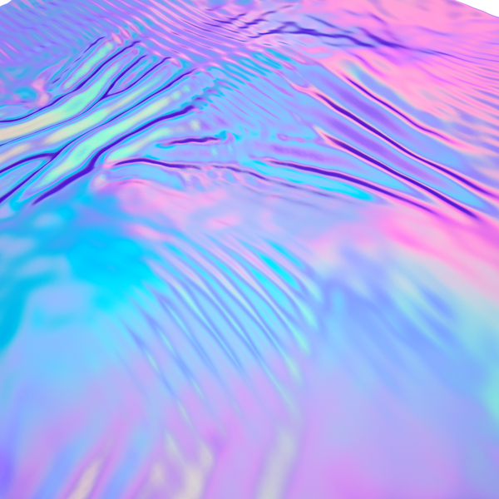
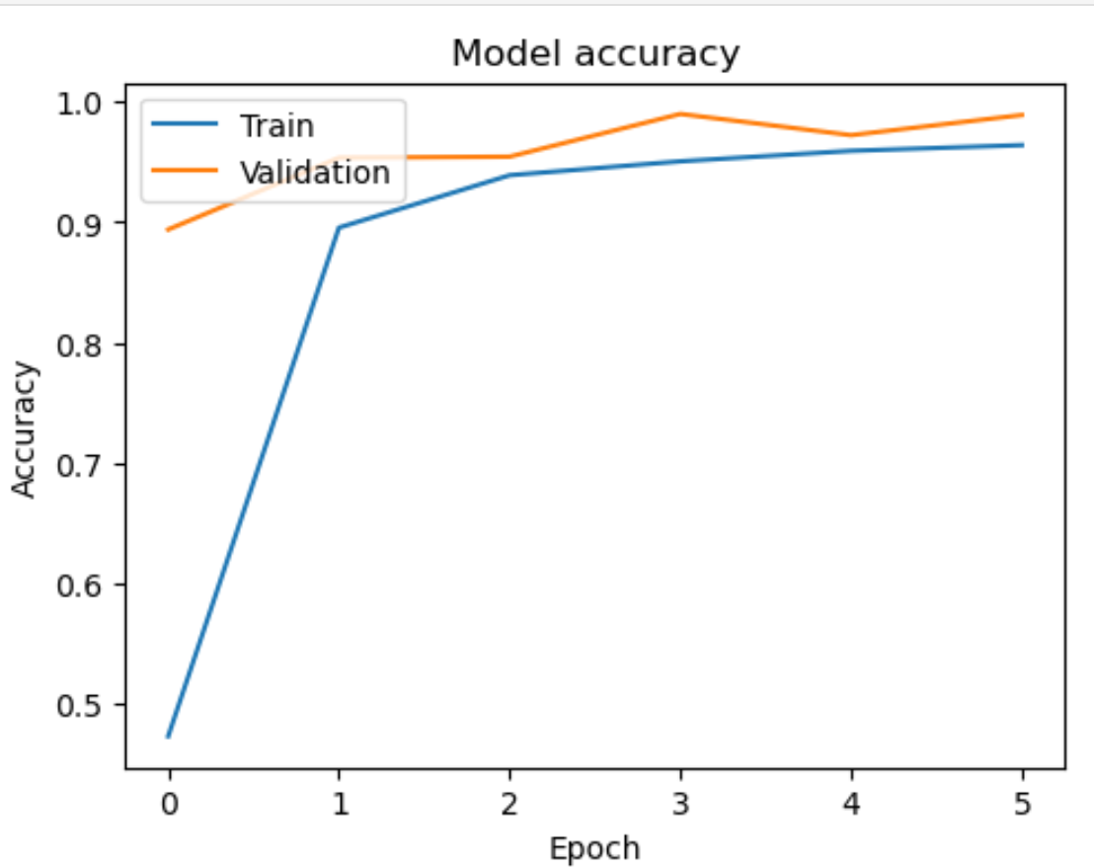
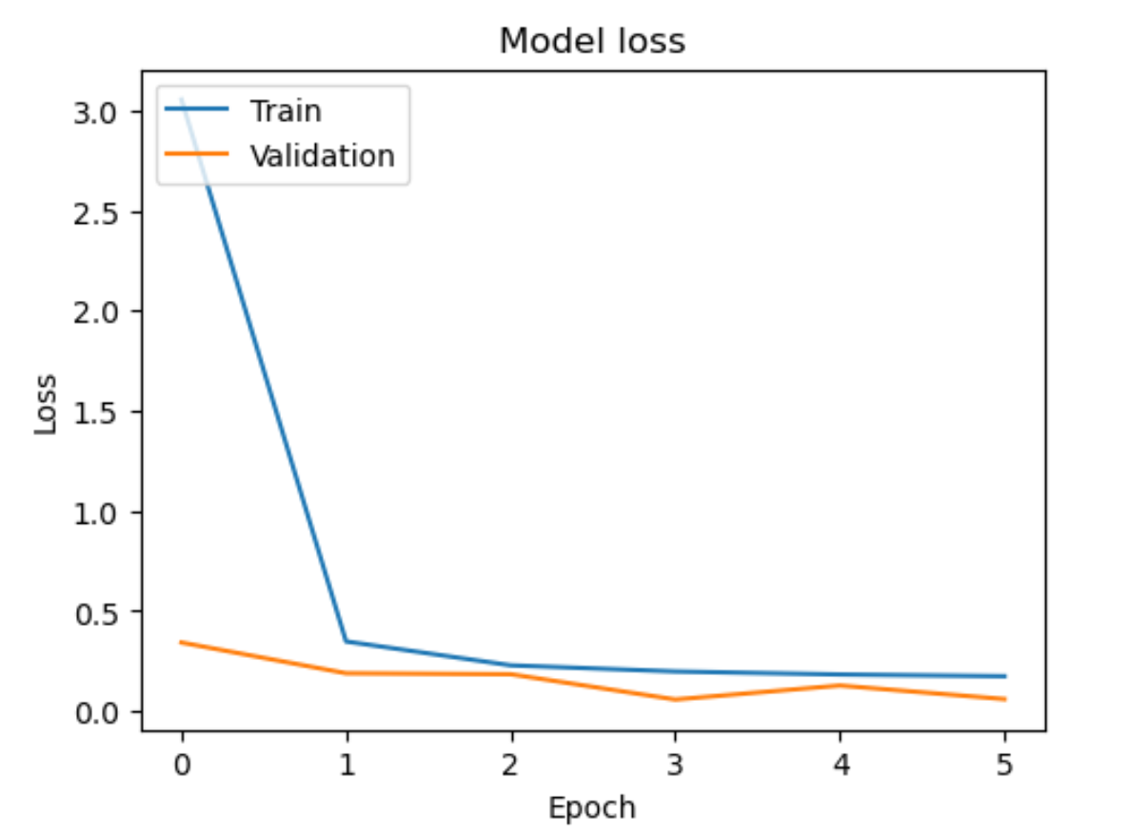

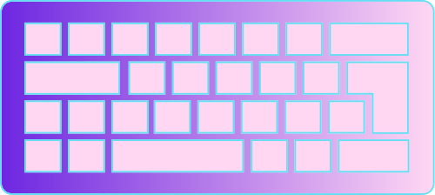
Results

Slide 15
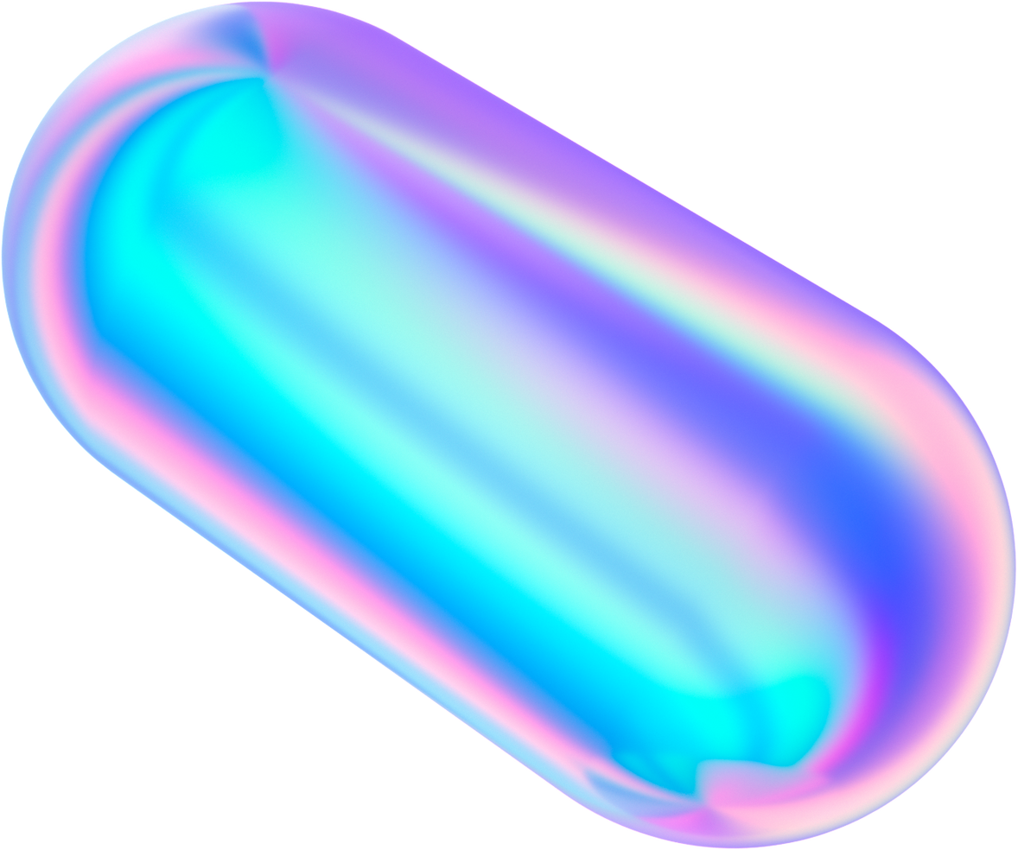

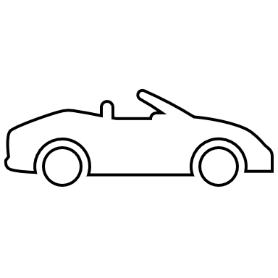
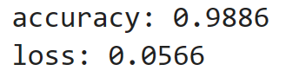
Conclusion
Effective Classification
Automated
Mointoring
Enhanced Road Safety

Slide 16
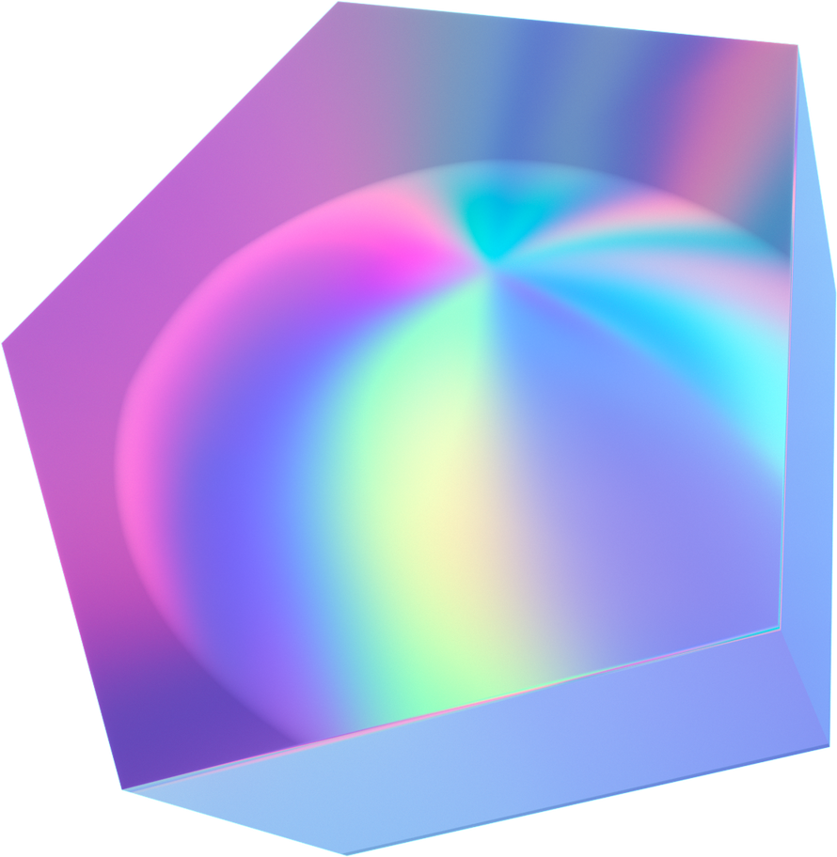
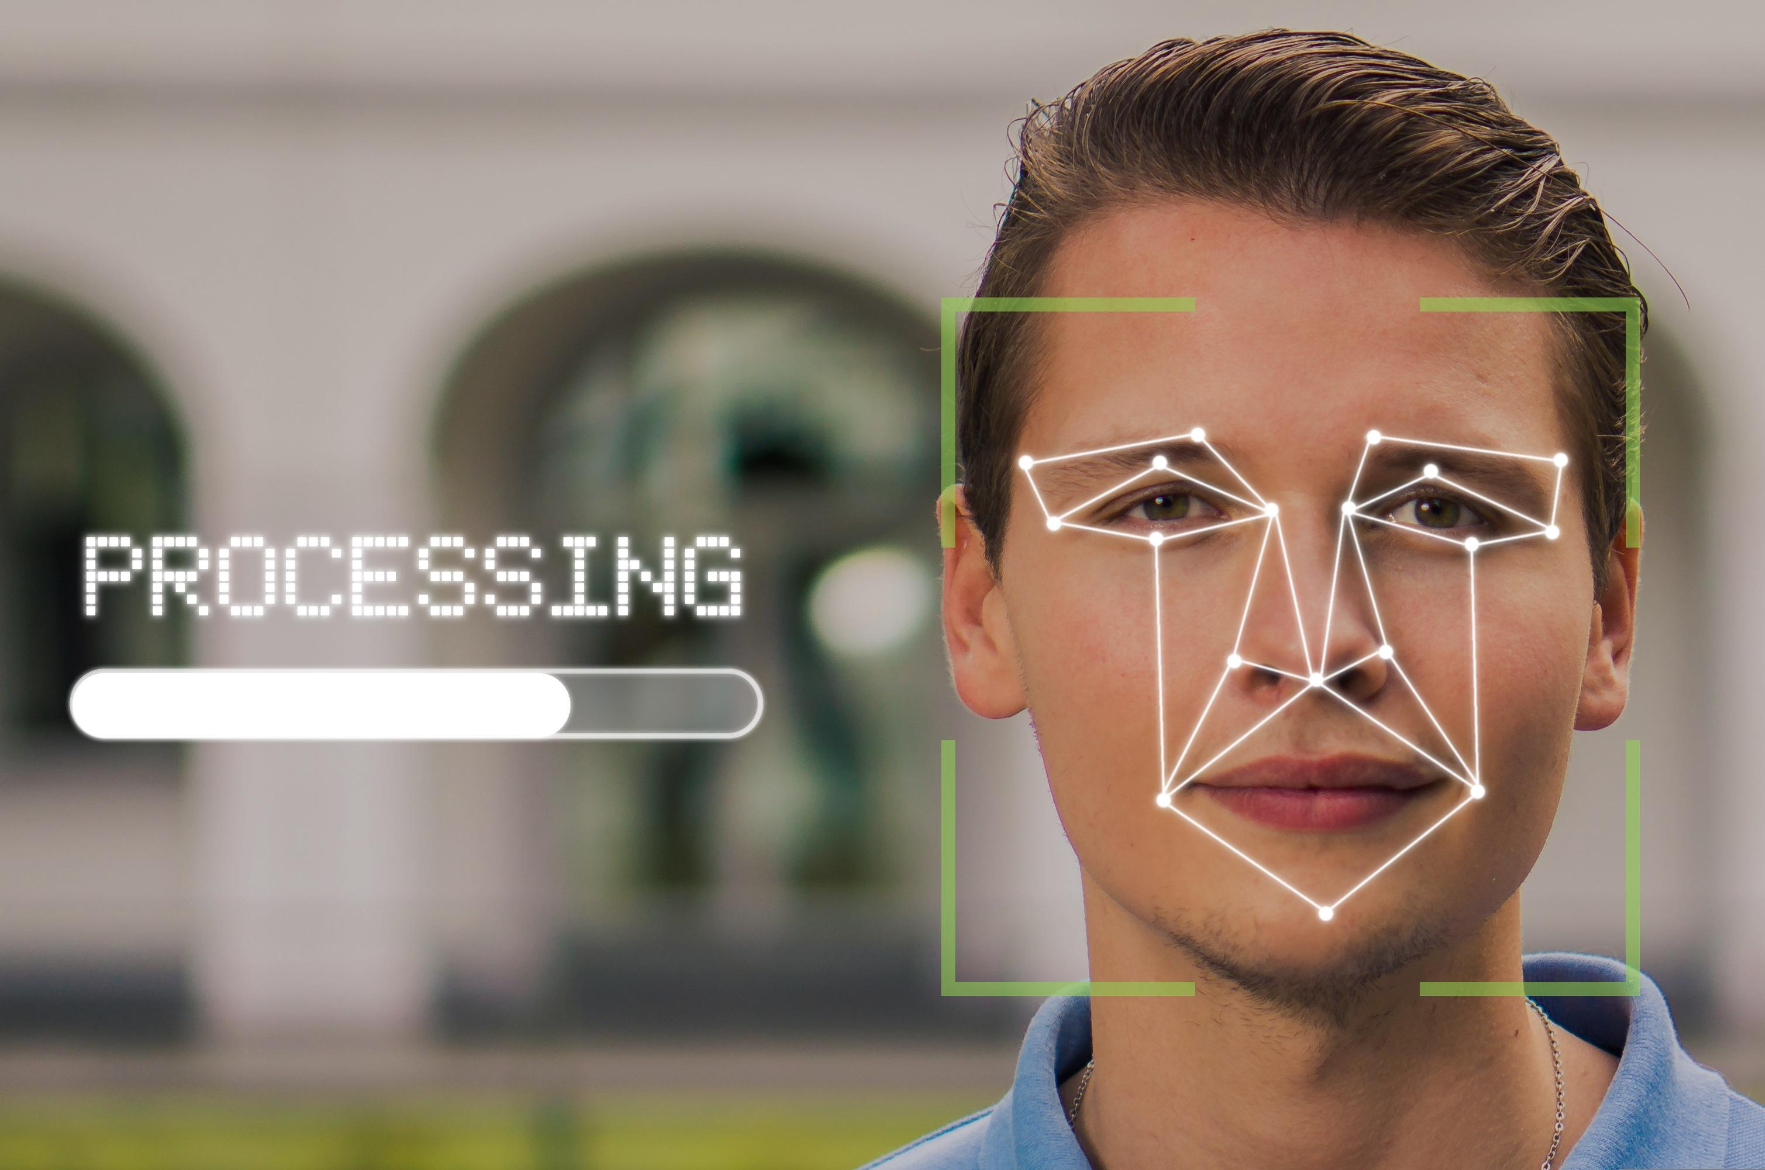
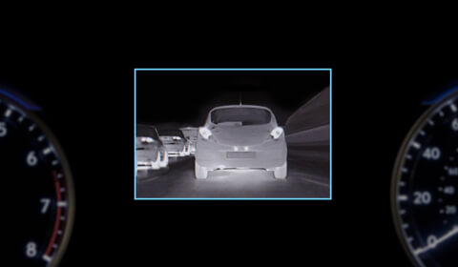
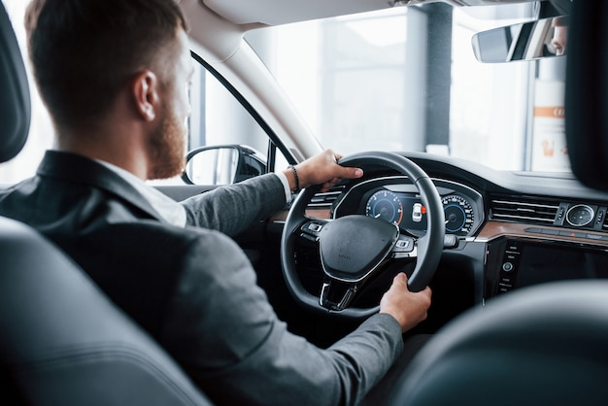
Future Works
Night Vision Capability
Facial Recognition
Integration
Dynamic Camera Detection

Slide 17
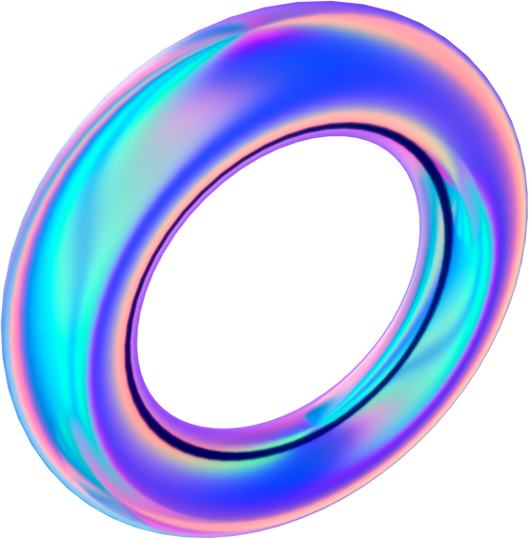

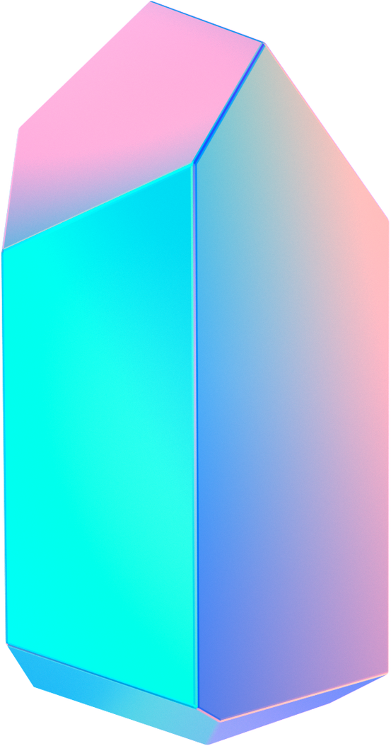
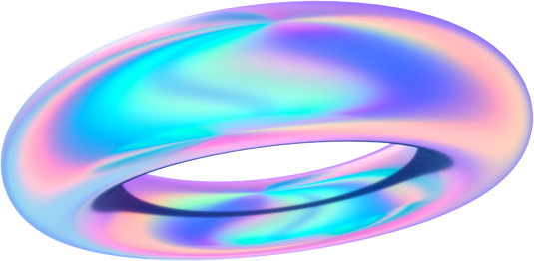
Thank you!

